Slide 1
tableau sheet
File created on: 1/17/2026 1:38:20 AM

Slide 2
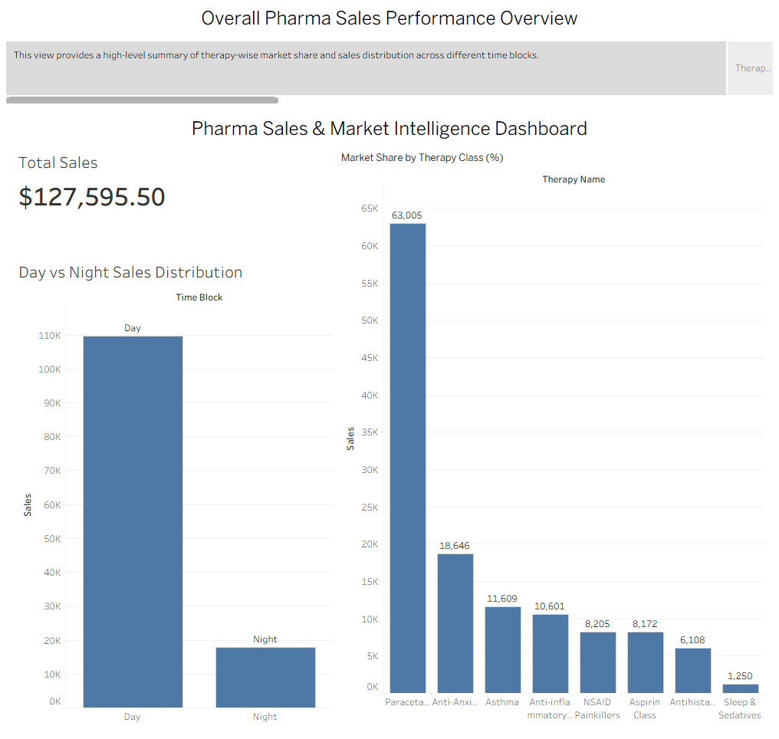

Slide 3
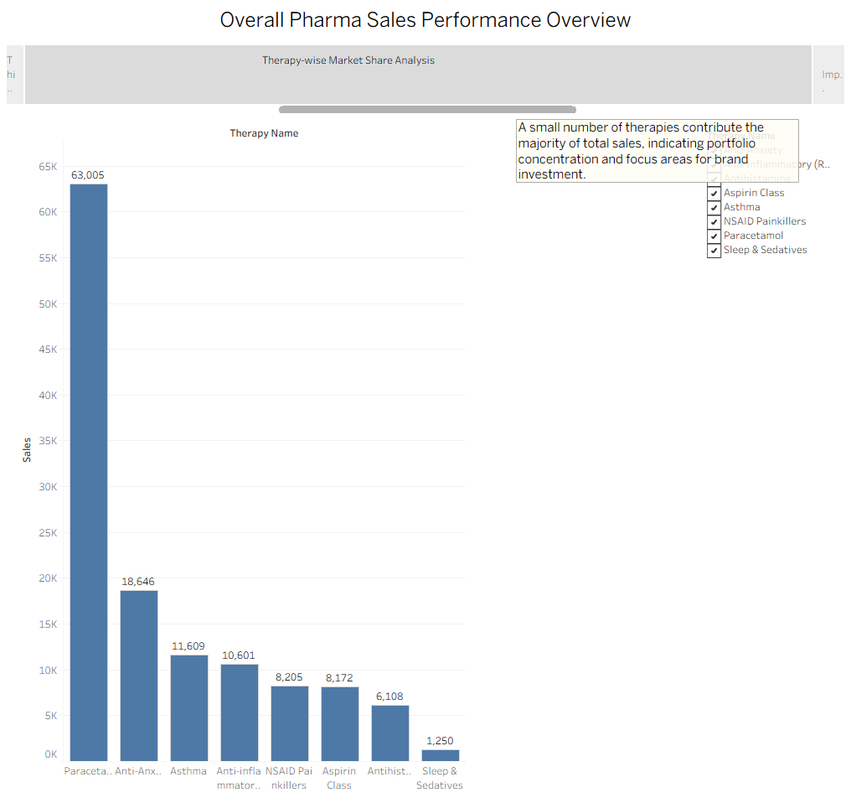

Slide 4
